Slide 1


Notes:
NOTES TO PRESENTER:
This presentation is meant to give an overview of the various patient care activities that student pharmacist members of APhA-ASP can participate in.
Tips for Customizing these slides:
1. Include a photo from one of your chapter patient care projects
2. Include unique ways that your chapter allows students to experience their education

Slide 2
Awards Ceremony
  Patient Care Projects
  Patient Counseling Competition
Leadership Workshops
  Attend several APhA workshops for certification
Presidential Address
National Executive Committee Elections
Political Advocacy

Slide 3



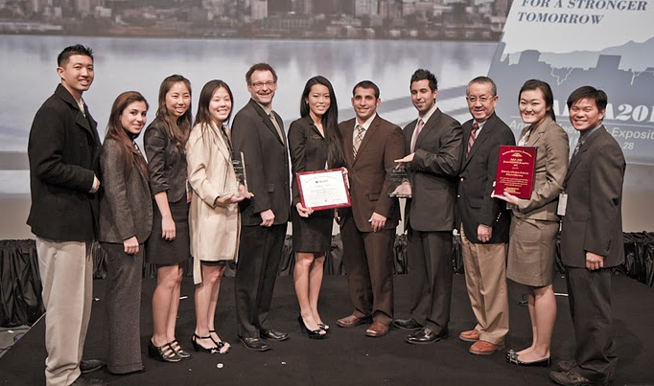



Awards – Patient Care Projects
National
SHARE/CHANCE
Operation Diabetes
  3 years in a row!
Operation Immunization
Regional
Operation Heart

Slide 4
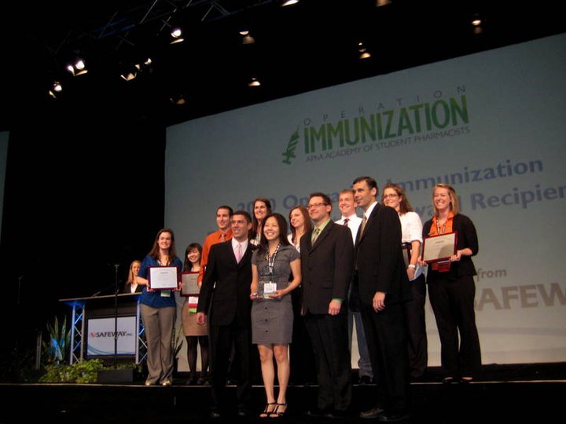
Awards – Patient Care Projects

Slide 5
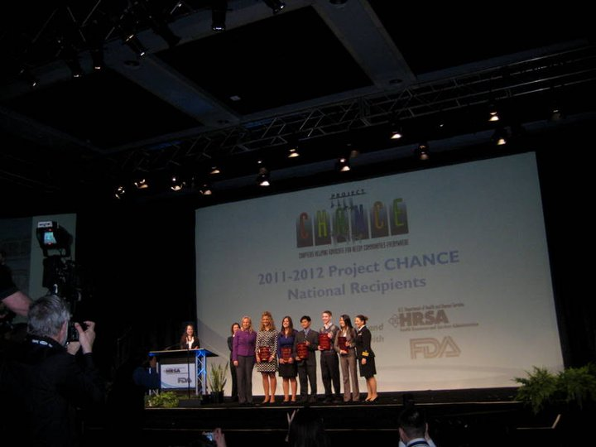
Awards – Patient Care Projects
Notes:
5

Slide 6
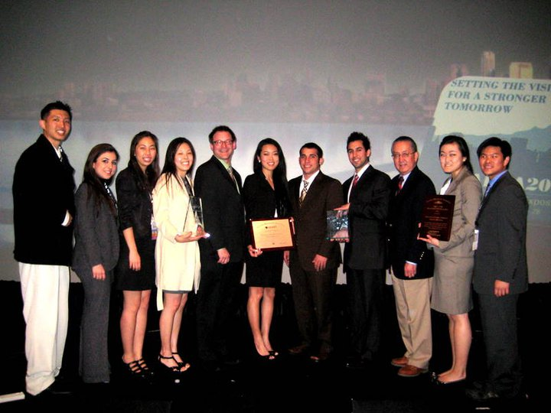
Awards – Patient Care Projects

Slide 7

Patient Counseling Competition

Slide 8
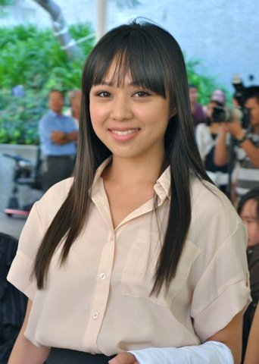
National Executive Committee Elections
Lucie Vu
Midyear Regional Meeting Coordinator

Slide 9
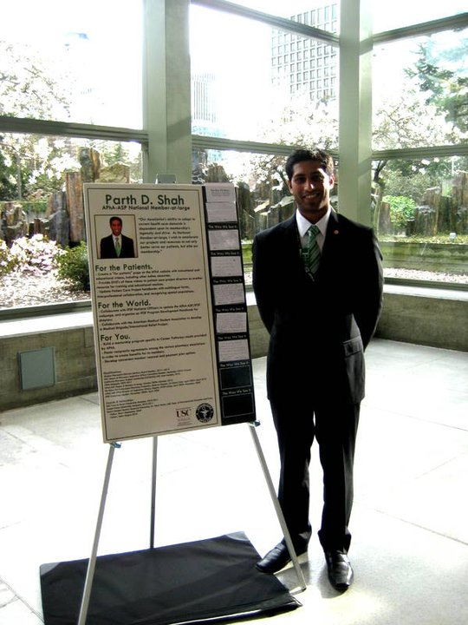
National Executive Committee Elections
Parth D. Shah – Elected as National Member-at-Large!

Slide 10

APhA Annual 2012 Opening Session
Key Note Speaker : Thomas Goetz
executive editor of WIRED magazine and author of The Decision Tree: Taking Control of Your Health in the New Era of Personalized Medicine.

Slide 11
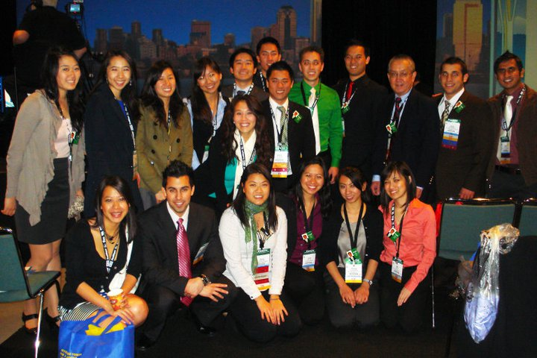
Educational Sessions
Patient Counseling Competition
MTM
Political Advocacy – APhA House of Delegates
Self-Care Strategies
New Therapeutic Entities
Residency Workshops
Workshops for chapter officers
  membership, legislative, presidents

Slide 12
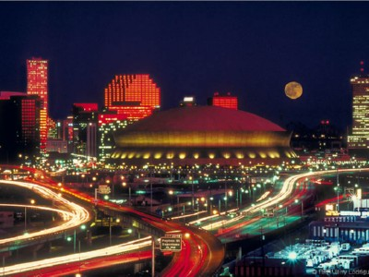
Registration
Early Bird Registration
  Deadline: February 9th
  Members: $215 → $265
Register Online
  Email address
  Password: Can be retrieved from APhA Homepage
  No need to pay for extra sessions

Slide 13
Scholarship
$100
Limited to 50 students
Sign up Tuesday, 2/7/12 at 9:30 PM
Must register for full conference
Must be APSA members
Must attend 3 of 5 required events
Turn in complete reimbursement with original conference badge two weeks after conference

Slide 14
Required Events
Saturday, March 10
  9:00 – 11:00 AM: APhA-ASP Opening General Session
Sunday, March 11
  10:15 – 11:15 AM: Region 8 Caucus
  3:00 – 5:30 PM: APhA-ASP House of Delegates
Monday, March 12
  9:00 AM – 12 PM: APhA-ASP House of Delegates
  6 – 8 PM: APhA-ASP Awards Ceremony

Slide 15

Travel
Arrive Saturday morning or earlier
Plan to depart Monday night or later
Book Tickets Early to
avoid raising costs!!

Slide 16
Tips for Conference
Have fun!
Keep an open mind
Download the APhA Annual App
Bring business cards
Bring comfortable shoes, business attire
…and night time attire to enjoy New Orleans!

Slide 17
See you in New Orleans!

Slide 18
Questions?
email: nbolour@usc.edu

Slide 19
Upcoming APSA Elections
Elections 2012
Info session
  February 16
Elections
  March 1
Newly elected board members highly encouraged to go to APhA Annual 2012

